Slide 1
Random Forest
A Visual Explanation
by Jennifer Yoon

Slide 2
Random Forest is a combination of Decision Trees.
One of the main drawbacks of Decision Trees is that they are very prone to over-fitting: they do well on training data, but are not so flexible for making predictions on unseen samples.

Slide 3
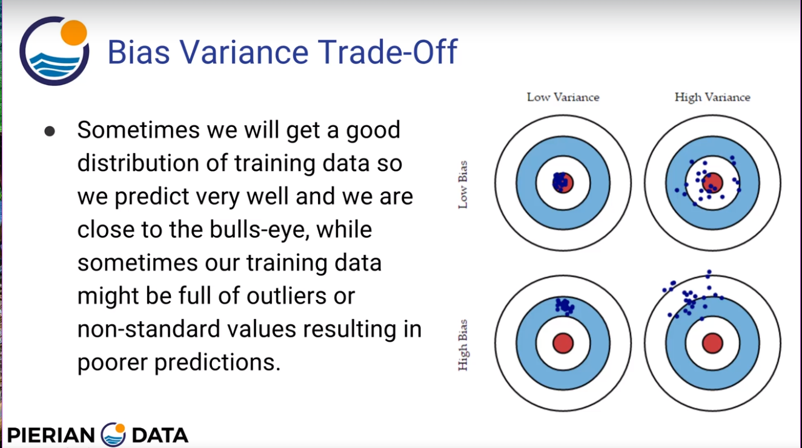

Slide 4
We use random sampling to overcome over fitting.
1. Randomly select partial rows (data sample)
2. Randomly select partial columns (features)
3. Combine and average to get predictions

Slide 5
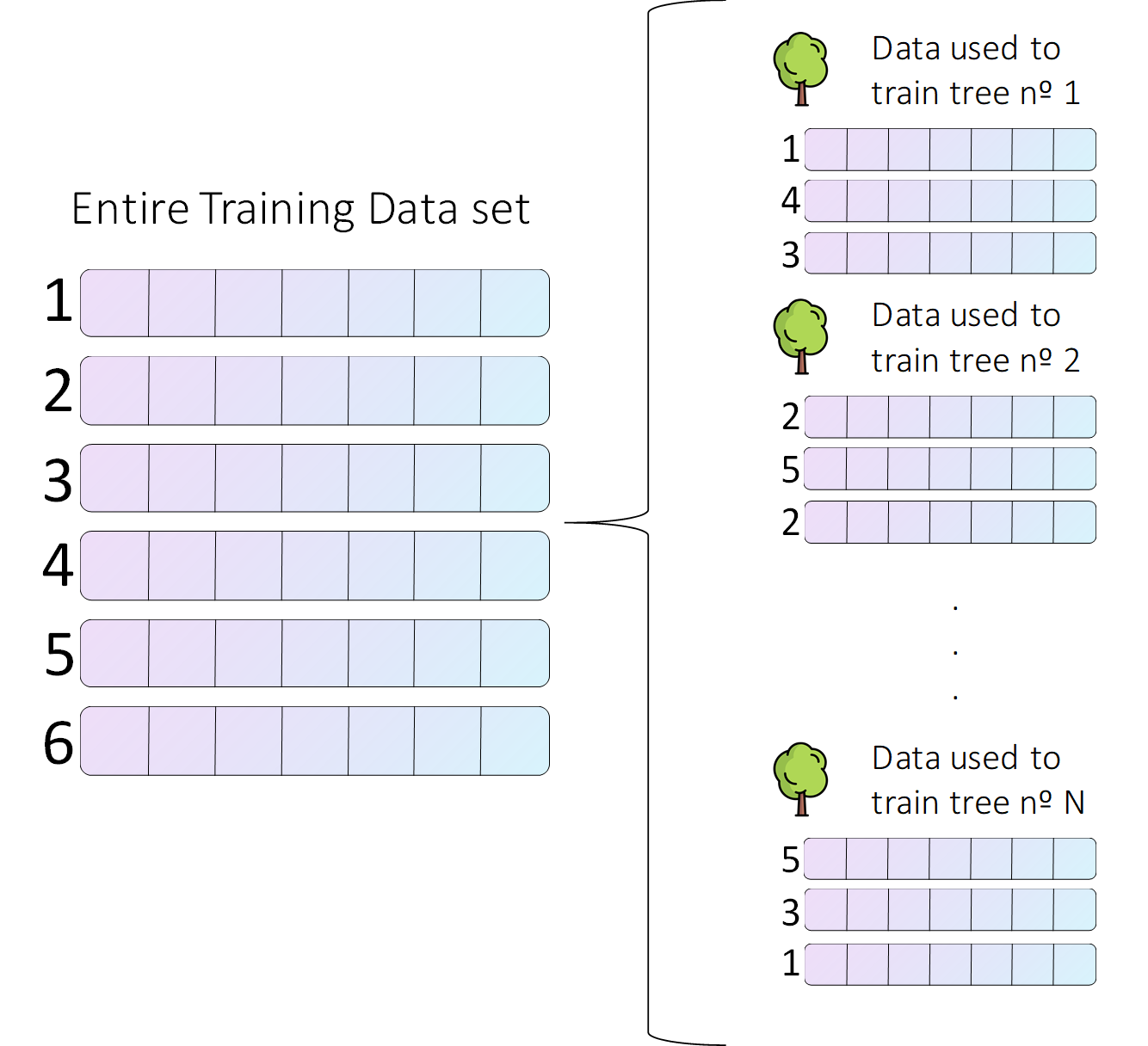

Slide 6
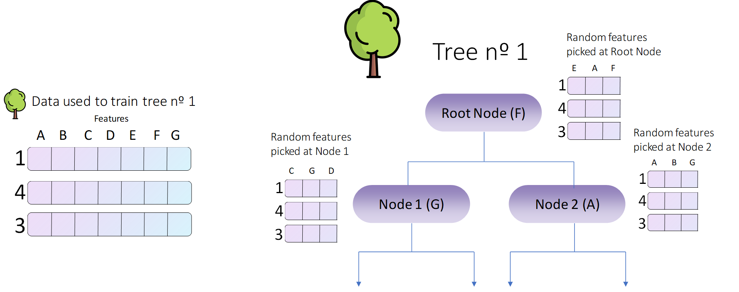

Slide 7
In conclusion, the whole process goes as follows:
1. Create a bootstrapped data set for each tree.
- Randomly select partial rows (data items)
2. Create a decision tree using its corresponding data set, but at each node use a random sub sample of variables or features to split on.
- Randomly select partial columns (features)
3. Repeat these steps hundreds of times to build a massive forest with a wide variety of trees. This variety is what makes a Random Forest way better than a single decision tree.
- Each tree has high variance but low bias (centered)
- Many overlapping tree variances average to a better predictor

Slide 8
Once we have built our forest, we are ready to use it to make our predictions.
1. Categorical Model – discrete levels predictor
2. Regression Model – continuous levels predictor

Slide 9
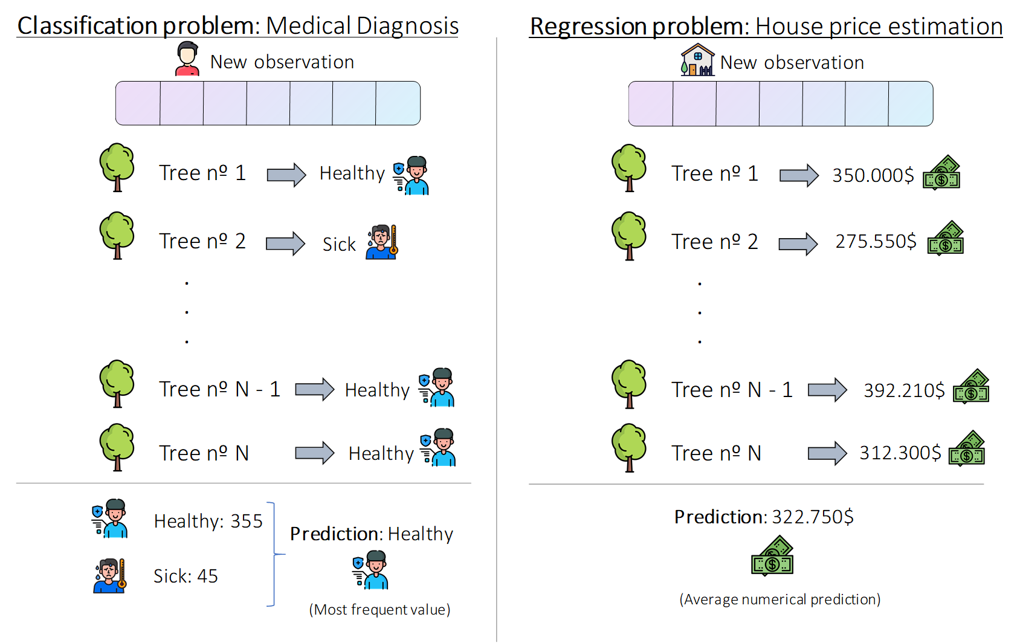

Slide 10
Overlapping Trees Diagram

Slide 11

Reference: Random Forest Explained, https://towardsdatascience.com/random-forest-explained-7eae084f3ebe
Reference: Pierian Data, Udemy
Notes:
co

